Slide 1
Cubesat mission to study venus’ atmosphere
Exploring venus’ upper atmosphere with a compact satellite
Presented by :- milind , Kaustubh & omkar

Slide 2
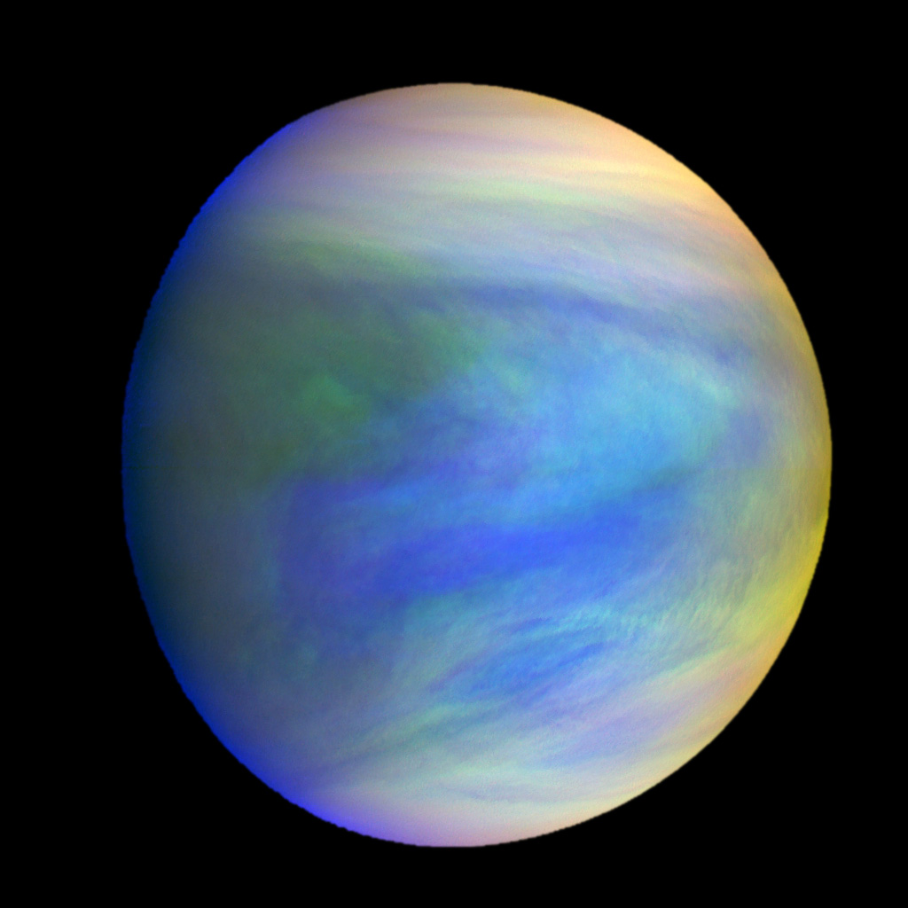
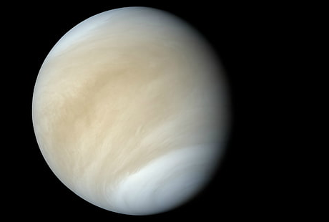
venus
Thick clouds of Venus reflects most of the sunlight (visible light) that falls on them. Venus is almost featureless when observed from Earth.
50% of the solar energy received by Venus is absorbed in UV by an unidentified absorbers in the top cloud layer.
In the UV we observe dark & light regions.
Clouds top structure and UV absorbers nature are key parameters for understanding the atmosphere of Venus
We know different molecules absorbs different uv of different wavelength.
Therefore we need Venus’ UV spectrum & UV imaging to study its atmosphere.

Slide 3
Mission overview
Objective: study the upper atmosphere and cloud layers of Venus.
Importance: understanding atmosphere composition , dynamics ,and potential climate parallels with earth.
Mission goal: gather data to enhance knowledge of Venus’ climate and its evolution.

Slide 4
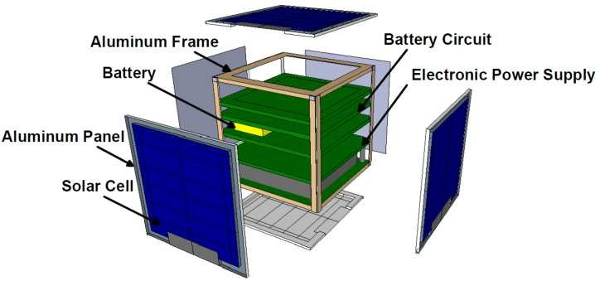
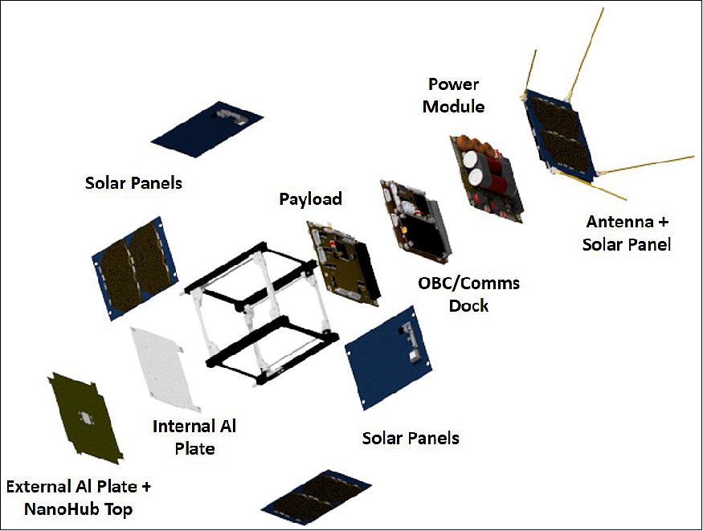
Mission design and orbit
Size of Cubesat :- 15cm x 15 cm x 15cm
Structure -> Carbon fibre.
Component of Cubesat :-
Payload :- 1) UV spectrometer
2) UV multispectral imaging
3) Sensors
Solar panels & power system
Attitude determination & control system
Communication system
Thermal control system
On board computer(OBC)
Orbit radius: 200-250 Km from Venus’ surface.

Slide 5
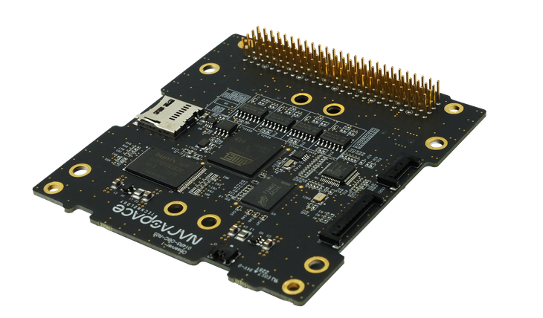
Obc (on board computer)
OBC is the brain of the computer
It manages the satellite when it’s not in the sight of ground station
Payload operation
Data collection and transmission
Safety operation – thermal control
End of mission

Slide 6
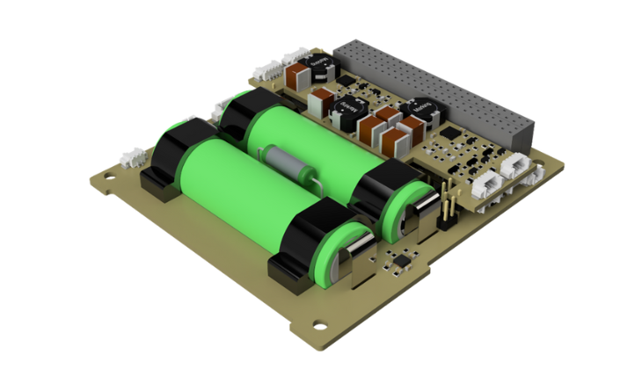
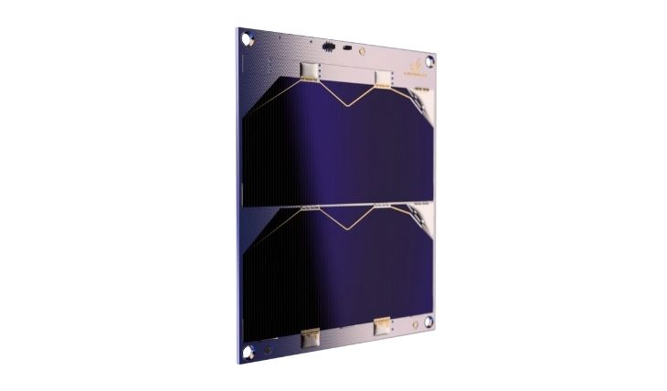
Power
1) Triple Junction Solar panels : generates power (approx. 53w generated)(30-35% eff.)
2) Battery(Li-ion) : stores power generated by solar panels(approx.. 37.5 wh)
3) Electrical power system: power distribution unit (supply)
power control unit (control)
include voltage converters, sensors

Slide 7
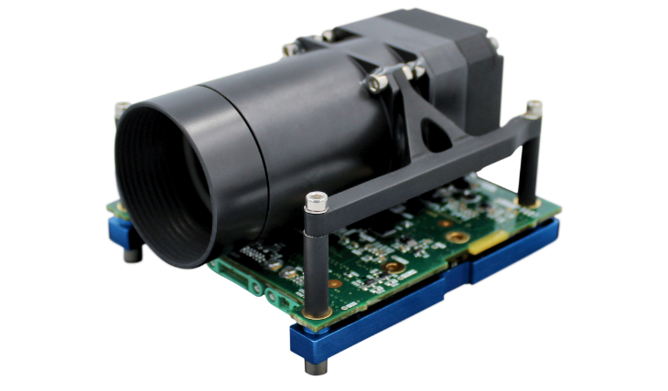
sensors
UV imaging spectrometer : observe & measure UV light in Venus’ atmosphere.
Solar radiation sensors : helps differentiate between solar UV light & atmosphere emission.
Attitude and orientation control sensors : Sun sensors , magnetometers & gyroscope.
Temperature sensors: Measures the thermal profile of Venus’ atmosphere.
Pressure sensors: Measures the atmospheric pressure.

Slide 8
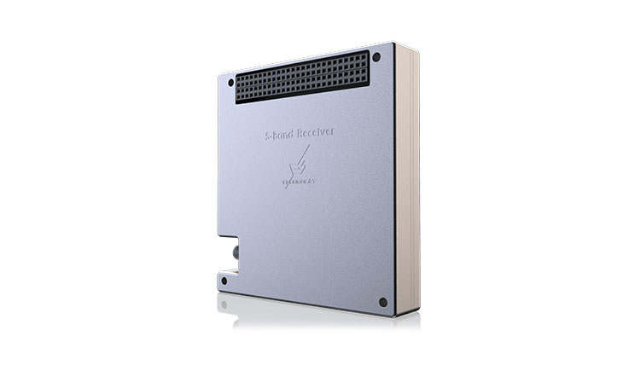
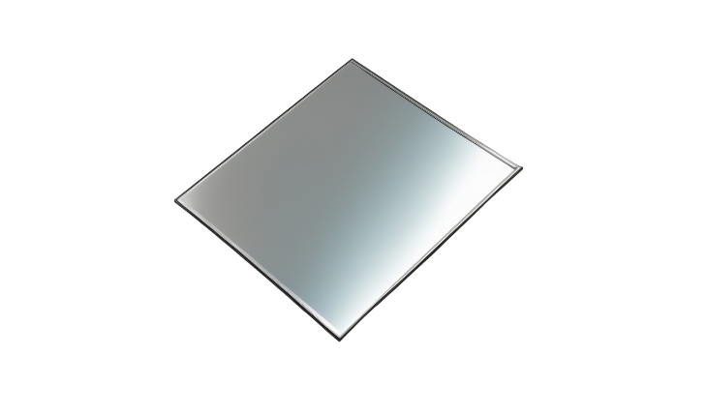
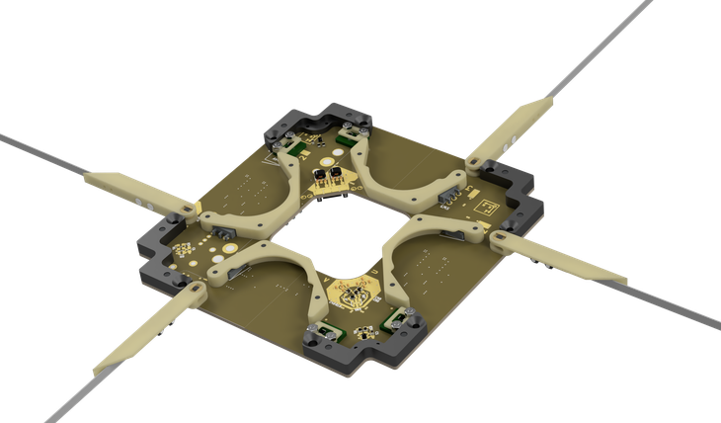
Communication
Radio transmitter and receiver
Antenna system
Telemetry (collect and transmits data from cubesat to
earth.)

Slide 9
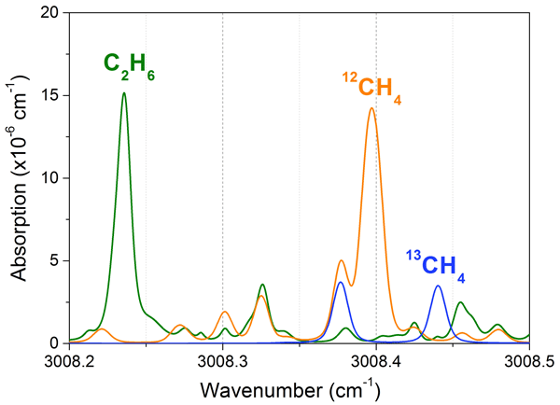
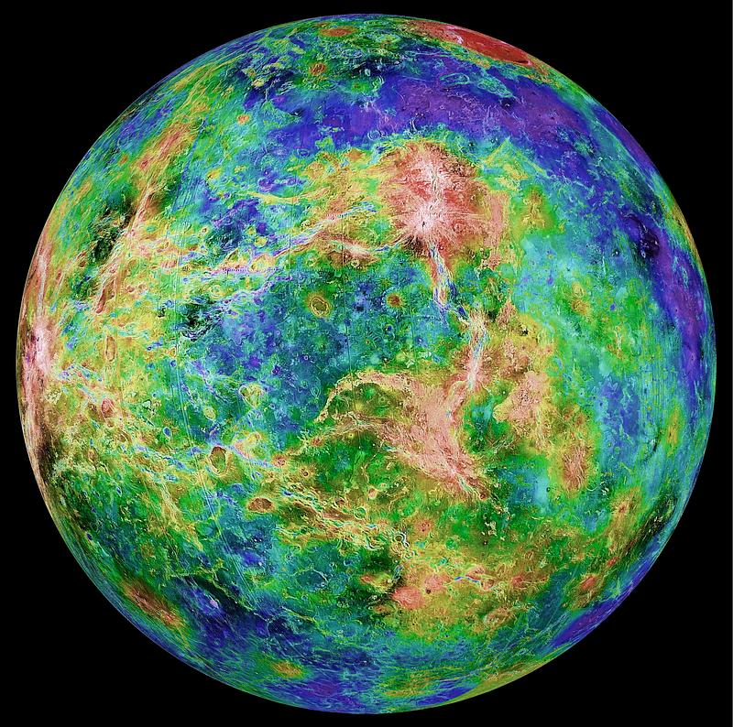
Payload : (collection of data)
UV component
UV spectrometer
UV multispectral imaging
Image with different wavelength :
Shows absorbers distribution in atmosphere
Structure of cloud & dynamics
Detecting & analysing electromagnetic radiation :
Molecules presents in the atmosphere

Slide 10
Known uv absorbers
Known absorbers :
SO₂ varies from 0.1 to 1 ppm at the cloud top
SO about 30% of SO₂
Other Sulphur bearing species ‐ sulphur S_{x}, S₈, S₂O, OSSO – FeCl₃
Recently :
Messenger MASCS found best fit for S₂O and OSSO
Other proposed absorbers:
SCl₂, Cl₂ and many others (C₃O₂, CH₂O, NOHSO4, NO₂ , N₂O₄, NH₃NO₂, (NH₄)₂SO₄, (NH₄)S₂O₅, NH₄Cl, Cl₂, SCl₂, HClO₄) source: cuve mission

Slide 11
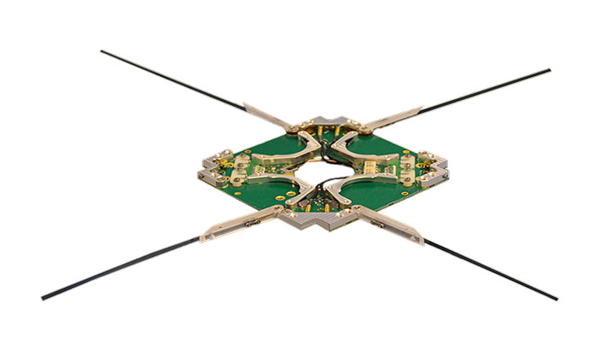
Transmission of data
Transmission of data is done with the help of radio waves.
Transmitted from the antennas of the Cubesat and received by DSN(deep space network).

Slide 12
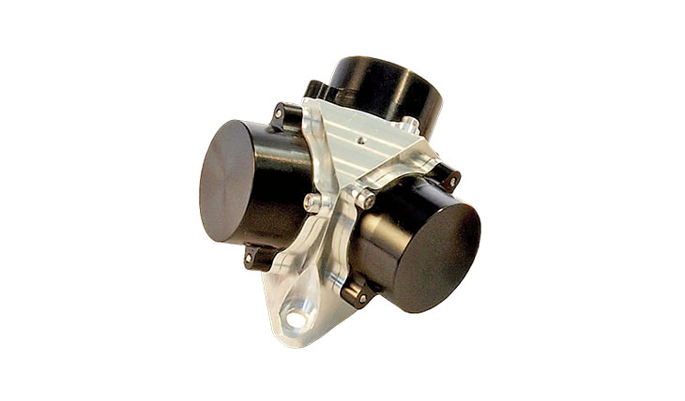
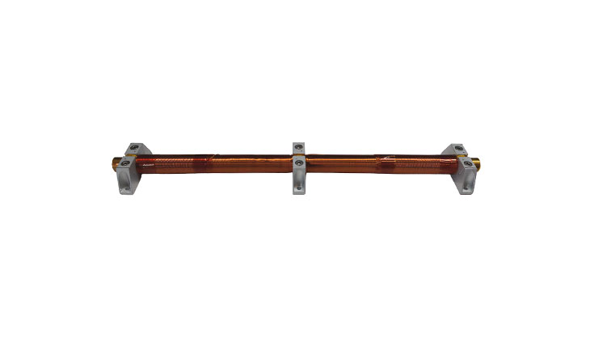
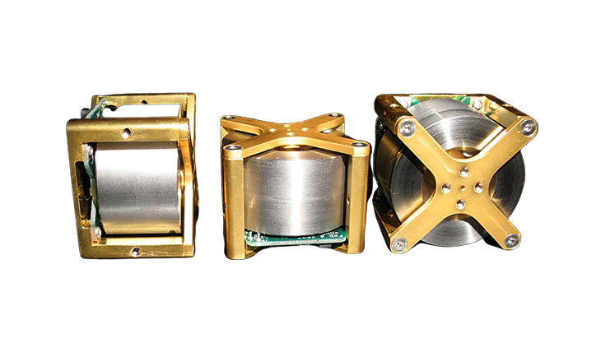
Maintaining of altitude
High altitude orbit must be chosen to avoid atmospheric drag from Venus’ thick atmosphere
Orbit stabilization and control :
Reaction wheel
Magnetorquers
Gyroscope
Thrusters (not used in our build)

Slide 13
Weight calculation
Component | Description | Weight | Power consumed/produced
Power system | Solar panel Batteries(Li-ion) | 500g 150g | 53 w solar panels 37.5 wh batteries
Structure | aluminum/carbon fiber | 200g | -
OBC | 1 | 50g | 0.5W
Communication system | Transmitter/receiver x 1 Antenna(UHF/VHF) x 1 | 100g 20g | 2W
Thermal control system | 1 | 50g | -
Attitude determination & control system(ADCS) | magnetorquers,gyroscope and reaction wheel | 100g | 0.1-2 W per axis (magnetorquers) 0.05-0.5 W per axis (gyroscope)
Deployment mechanism | 1 | 30g | -
payload | UV spectrometer (300g), UV multi spectrometer imaging (200g), Other sensors | 570g | 3-6 W (spectrometer) 2-5 W (multi spectrometer imaging sensor)
 | Total | 1.77kg | Consumed power=7.95 to 21

Slide 14
challenges
1) Over heating of solar panels :
We need proper orientation to avoid over heating.
2) Delay/fail in transmitting data :
Due to large distance between Earth and Venus strength of signal may become weak & delay in data transmission may occur.
Small size of Cubesat may limit the power generation, which could restrict the amount of data that can be transmitted.
Cubesats, in general, have a very limited data return capability because of limited antenna aperture size and power.
3) Shielding failure : Radiation from the sun can damage the electronics.
4) Accidental discharge of battery :
May cause premature activation.
Rechargeable batteries must be fully discharged or deactivated during the launch

Slide 15
Thankyou

